Slide 1
LESSON-7
PACKING
By Jerome K Jerome (an extract from Three Men in a Boat)

Slide 2
INTRODUCTION
Packing is a story about three friends who are getting ready to go for a journey. It follows the packing session of three friends, Jerome, Harris, and George. Thus, it begins with them starting the most important thing of a journey, packing! This story is an extract taken from Three Men in a Boat by Jerome K. Jerome. In this story, Jerome is the narrator himself and writes about the experience he has while his friends decide to start packing. Further, it takes us on a hilarious ride about three adults who struggle to do a basic thing as packing. The story will take you through the nuisances they experience in addition to their dog, Montmorency’s contribution. Similarly, it also shows how his other two friends are not that great when it comes to packing.

Slide 3
SUMMARY
As Jerome, Harris, and George are ready to set out on a journey, they start packing for it. Being the narrator, Jerome describes how the packing experience went. We can see that Jerome is quite confident with his packing skills as he handles it all alone. While in reality, he wishes to simply supervise the packing session while making his friends do the work under him. However, they listen to him and let him handle it all by himself, while they sit and relax. This does not impress Jerome; nonetheless, he gets to it. Finally, after a long packing session, he packs the bag up while his friends watch him quietly do all the work. Soon, Harris tells him about the shoes that he did not pack and Jerome will have to reopen the bag to make space for them. Thus, after learning about the shoes, Jerome remembers his toothbrush which he did not pack. In order to find it, he empties the whole just for one toothbrush. Alas, he finds it inside a boot and packs the bag again.

Slide 4
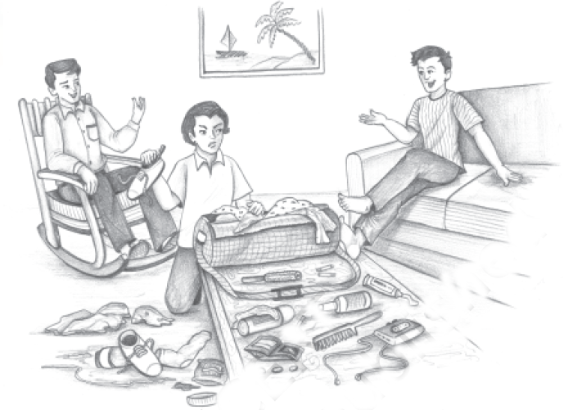

Slide 5
SUMMARY
After that, we see that one more query arises for the soap by George. Consequently, this irritates Jerome so much that he does not pay heed to it and packs the bag anyway. However, to his mistake, he has to reopen it again due to his spectacles being locked inside the bag. This packing session finally concludes at 10 o’clock.
So, we see that after taking such a long time to pack, Jerome’s other two friends pack the hampers themselves to show him how it’s actually done. However, they are also similarly gawky and break many things including a cup into pieces. Further, they squash tomatoes and tread on butter while also smashing the pies. In addition, there is salt flying here and there during this process. Thus, after much chaos, they try to put things back in order.

Slide 6
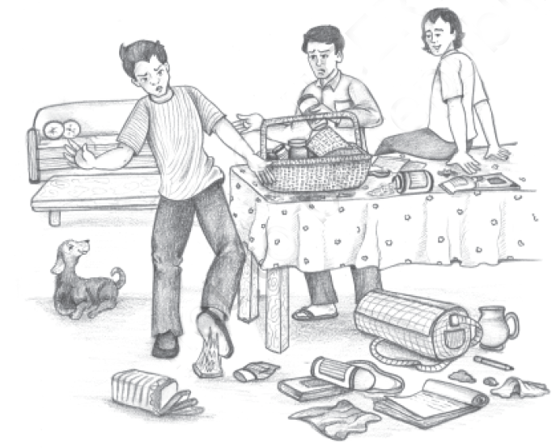

Slide 7
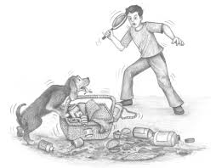

Slide 8
SUMMARY
However, it is not as successful as their pet dog, Montmorency, worsen things. He sits on things meant to be packed and climbs into the jam as well as crushes lemons as if they were rats. But, finally, the final packing ends at around 12:50 in the night. After a tiring packing session, they decide the time to get up for the next morning and George dozes off before engaging in this conversation. In the end, Jerome and Harris mark 6:30 as the wake-up time and go off to sleep.

Slide 9
SUMMARY
The narrator of the story, Jerome, was proud of his packing skills. He was supposed to go on a trip with his friends George and Harris. He told them to leave the whole matter of packing to himself, to which they readily agreed. George sat on the easy chair and Harris cocked his legs on the table and watched Jerome do the packing. But this wasn’t what Jerome wanted. When he said that he wanted to do all the packing himself, what he meant was that he was willing to be in charge of everything and direct his friends to work efficiently under his supervision. He was really pissed at them for just sitting about watching him work. It was uncomfortable for Jerome to just sit idle and see another person work alone. His energetic nature made him want to get up and superintending skills.

Slide 10
SUMMARY
He was supposed to go on a trip with his friends George and Harris. He told them to leave the whole matter of packing to himself, to which they readily agreed. George sat on the easy chair and Harris cocked his legs on the table and watched Jerome do the packing. But this wasn’t what Jerome wanted. When he said that he wanted to do all the packing himself, what he meant was that he was willing to be in charge of everything and direct his friends to work efficiently under his supervision. He was really pissed at them for just sitting about watching him work. It was uncomfortable for Jerome to just sit idle and see another person work alone. His energetic nature made him want to get up and superintend.

Slide 11
Q & A
Q1. How many characters are there in the narrative? Name them. (Don’t forget the dog!).
Q2. Why did the narrator (Jerome) volunteer to do the packing?
Q3. How did George and Harris react to this? Did Jerome like their reaction?
Q4. What was Jerome’s real intention when he offered to pack?
Q5. What did Harris say after the bag was shut and strapped? Why do you think he waited till then to ask?
Q6. What did George and Harris offer to pack and why?
Q7. Why did Jerome have to reopen the packed bag?
Q8. What “horrible idea” occurred to Jerome a little later?

Slide 12
SUMMARY
When Jerome packed the bag, Harris pointed out that Jerome had forgotten to pack the boots. So, he had to open the bag again and pack his boots in and just he was going to close it, he doubted if he had packed his toothbrush. Whenever he would be about to travel, he would get nightmares of forgetting to pack his toothbrush. Then he would wake up and go on to hunt for it. Then, in the morning, he would pack it before he used it and then he had to unpack again to get it and would repack, forgetting to put the toothbrush in again. Then, he had to rush upstairs to fetch it. He always ends up carrying the toothbrush wrapped up in his pocket-handkerchief.

Slide 13
SUMMARY
As usual, Jerome had to search the whole bag. He found George’s and Harris’s toothbrushes eighteen times over but he couldn’t find his own toothbrush. At last, he found it inside a boot and he had to repack once more. After he was done, George asked him if the soap was in but Jerome was so exhausted that he just didn’t seem to care. But after he strapped the bag again, he noticed that he had packed his spectacles inside and he had to open the bag again. Finally, he finished packing at 10:05 pm and now George and Harris decided to pack the food hampers.

Slide 14
SUMMARY
George and Harris started by showing that they were better than Jerome at packing. Jerome was excited to see how they would proceed. As he anticipated, they started with breaking a cup. Then, Harris accidentally squashed a tomato by placing strawberry jam on top of it and then he had to pick out the tomato with a teaspoon. Moreover, George stepped on the butter. Now it was Jerome’s turn to sit back and watch them which irritated them. They stepped on things, put things behind them, and then they were unable to find them when they needed them. They put the pie at the bottom and put heavy things on top of it, which ended up ruining the pies. They poured salt all over the place and did wonders with the butter.

Slide 15
SUMMARY
George got the butter stuck to his slippers. After he got it off his slippers, they attempted to put it in the kettle but it wouldn’t go in. Then they put it down on a chair but Harris sat on it and the butter stuck to his back. Then they went around looking for it. After a lot of searching, George discovered that it was at the back of Harris the whole time and finally they packed it in the teapot.
And then their pet dog, Montmorency, came into the scene only to add to the commotion. Montmorency was a naughty dog whose aim in life was to create hurdles and get scolded. It was only when he was screamed at that he felt that his day had not been wasted. So, just when things were ready to be packed, he came into the room and sat on them. Whenever Harris or George extended their hand for anything, Montmorency made it a point that they reach for his nose. He put his leg into the jam, disorganized the teaspoons and hampered the lemons.

Slide 16
SUMMARY
After uncountable obstacles and tremendous efforts, finally, the packing was done at 12:50 and Harris sat on the hamper hoping that nothing was broken. George consoled himself and Harris by saying that if anything was found broken then it would be because it was already broken.
They all were ready for bed and decided to wake up at half past six. George was already asleep by then. So, George and Jerome placed the bath where he could tumble into on getting up in the morning and went to bed themselves.

